Slide 1
OECD Well-Being Data
A Global Perspective on Ecomonics and Well-Being
Power BI Assessment
MT412 – Business Analytics Portfolio
Linus Lehr (22108475)
Vincent Stilz (22108521)
Caroline Ziegler (22108564)
Chantal Stefan (22108513)
Sebastian Gaycken (22108416)
Presentation of Dataset Analysis
Date: 21.03.2024
Place: Dublin, Ireland

Slide 2




Fostering a deep understanding of your dataset and extracting meaningful conclusions using Power BI's dynamic reporting features
Table of Contents
Table of Contents
Dataset Presentation
Data Analysis
Discussion of Insights
Conclusion
Check data integrity and completeness
Basic feature engineering
Review dataset metadata for context
Align indicators with research/policy interests
Conceptualisation of findings
Organising the findings
Prioritisation of most relevant insights
Utilize Power BI's built-in statistical functions for data relationships
Create Power BI dashboards for multivariate analysis visualizations
Design interactive Power BI reports
Summarize key analytical findings
Present recommendations based on data

Slide 3




The tailored and structured data is pivotal for conducting in-depth analytical research that leads to insightful discoveries
Dataset Introduction
The Well-Being Data
Source:
Provided by the OECD (Organisation for Economic Co-operation and Development) in 2017, involving extensive consultation with OECD member countries to select indicators
Scope:
Covers 34 topics related to well-being and economic indicators of the OECD countries.
Each topic is represented by one to three indicators, reflecting a broad spectrum of societal well-being aspects.
Objective:
Aims to involve citizens in the debate on measuring societal well-being and empower them in the policy-making process.
Seeks to provide a comprehensive, comparative measure of well-being across OECD member countries, based on a set of carefully selected indicators.
Data Quality:
Structured data aggregated by country, with indicators averaged within each of the 11 topics
Cleaned data available in formats conducive to analysis and research, such as CSV or Excel

Slide 4







A broad-scale dataset analysis dissects 34 critical economic and well-being indicators, offering a comparative view across OECD countries
Dataset Introduction
The Well-Being Data
World Map of OECD Countries¹
Housing Quality and Affordability:
Insights on dwelling quality, affordability via expenditure on housing, and space per person
Income and Wealth:
Data on disposable income and net financial wealth hint at financial stability and savings
Employment and Job Security:
Indicators of job market health, including employment rates and security against long-term unemployment
Health and Well-being:
Metrics on self-perceived health, life satisfaction, and safety at night reflect physical and mental well-being
Safety and Leisure:
Information on public safety via homicide rates and the balance of work with leisure time
Work-life Balance:
Working hours data provides insight into potential overwork and its impact on well-being
>
Note: (1) Australian Bureau of Statistics, GeoNames, Microsoft, Navinfo, Open Places, OpenStreetMap, TomTom, Zenrin

Slide 5






By analysing and visualising the data set, a series of insightful discoveries have emerged
Discussion of Results
Discussion of Results
The richest country is Luxembourg…
Higher personal earnings increase…
The countries with the highest life satisfaction are…
Life expectancy is influenced…
The air of South Korea…
Iceland is…
… positively by GDP per Capita & Quality of Support Network
… and negatively by homicide rate and dwellings without basic facilities
… has almost 10X more pollution than the air of Iceland
… the country with the best score on both environmental measures
… with almost three times the OECD AVERAGE for GDP / CAP
Rooms per person
Water quality
Safety
Life satisfaction
Iceland
Switzerland
Norway
Finland
Denmark

Slide 6




The data analysis across 3 main areas yielded significant findings and a comprehensive representation of key data within the OECD countries
Conclusion
Conclusion
Economic Indicators
Interactive presentation of economic factors such as GDP, GDP per capita, household income etc. per OECD country, with the values for the average, median, standard deviation
Employment & Education
Presentation of the employment and education situation per county based on a variety of measures and sub filters
Quality of Life
Visualization of Safety and health and environment measures per country with the ability to select according to the level of economic development
Comprehensive Data Discovery enables impactful Data-Driven Decision Making
Analysis of Insightful Correlations
Life expectancy shows a positive correlation with GDP per Capita, Quality of support network, and related negatively to dwellings without basic facilities and homicide rate
Personal Earnings are relating positively to rooms per person, water quality, safely and life satisfaction showing the importance of a country's economic status

Slide 7
Thank you!

Slide 8
Appendix

Slide 9
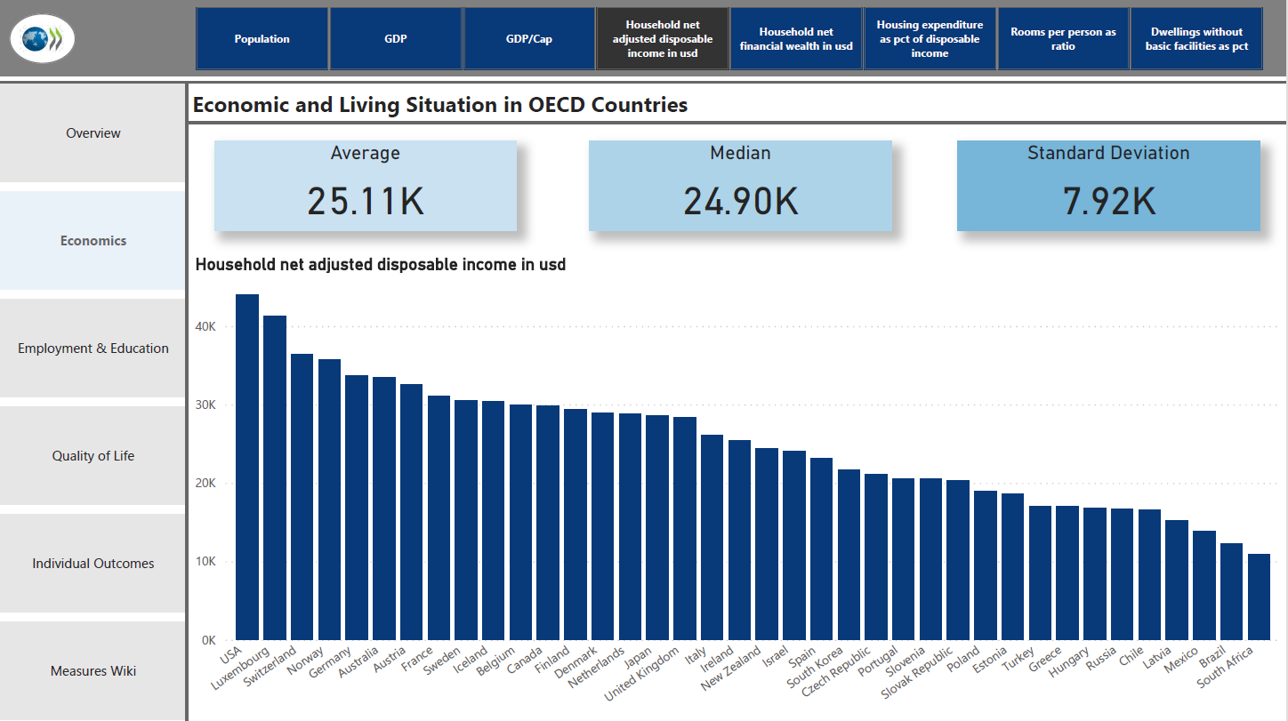
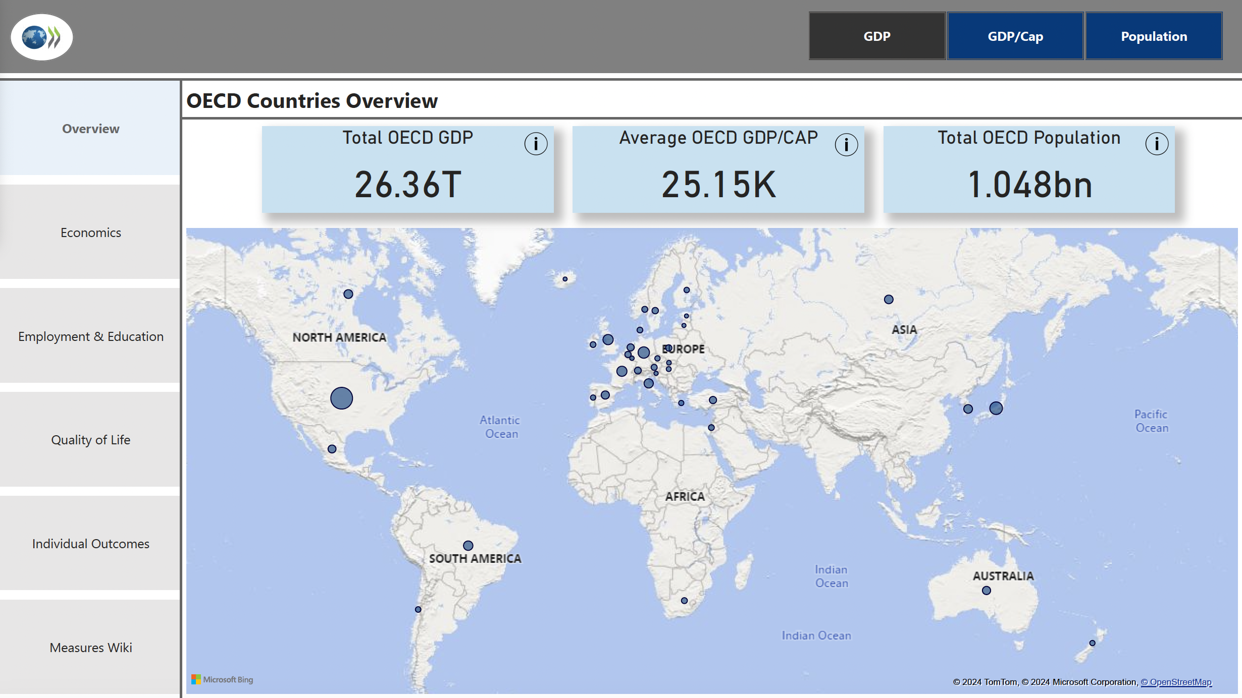
The dashboard provides an interactive overview of key OECD economic indicators via targeted visualization for in-depth analysis of various metrics
Appendix
PowerBI - Overview
Map Visualization
OECD countries with bubble sizes representing specific metrics like GDP or population are displayed in a map format.
Dashboard View 1
Key Indicators Overview
Total OECD GDP in trillions; Average OECD GDP per capita in thousands; Total OECD Population in billions are shown as the key metrics.
Sidebar Navigation
Tabs for navigating different data dimensions such as Overview, Economics, Employment & Education, Quality of Life, Individual Outcomes, and Measures of Well-being are enabled for easy handling.
Interactivity and Data Exploration
Options for clicking on map elements for more data, tab selection for varied views, and potential filtering, sorting, and detailed data pop-ups on hover are embedded.

Slide 10
The Power BI dashboard presents key aggregate economic figures alongside detailed bar charts comparing various economic indicators across OECD countries
Appendix
PowerBI - Economic Indicators
Aggregated Data Display
The key figures provide a quick statistical summary of the data, helpful for understanding the overall distribution across OECD countries.
Dashboard View 2
Bar Chart Visual
The use of a bar charts for various economic indicators effectively illustrates comparative statistics.
Comprehensive Country Overview
The respective distributions per OECD country are shown in order to facilitate comparison.
Extensive Selection of Indicators
Options for clicking on map elements for more data, tab selection for varied views, and potential filtering, sorting, and detailed data pop-ups on hover.

Slide 11
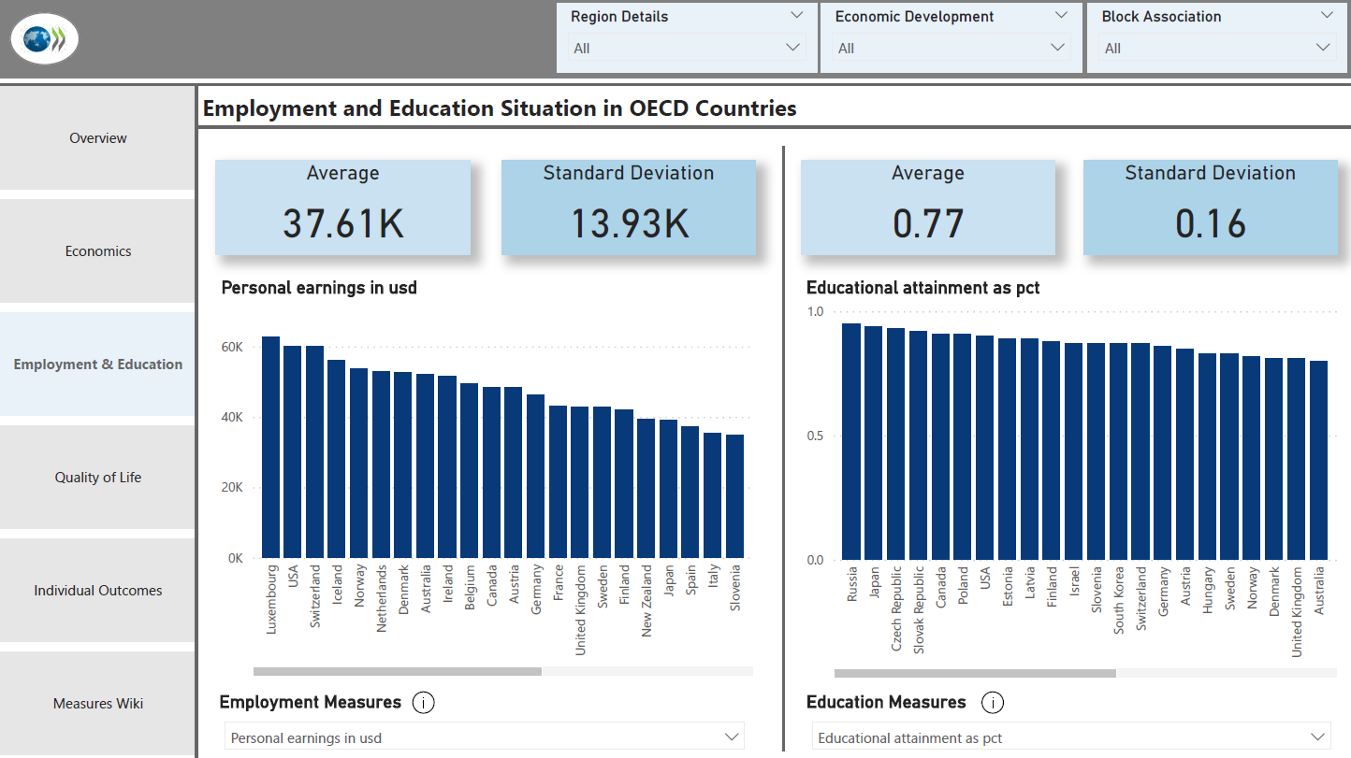
The slide juxtaposes employment earnings against education levels in OECD countries, using bar charts and statistical summaries to highlight trends
Appendix
PowerBI – Employment and Education
Dual Data Panels
Two panels, each with its own set of statistical data, indicating a focus on employment and education statistics within OECD countries.
Dashboard View 3
Interactive Features
Options for 'Region Details,' 'Economic Development,' and 'Block Association' suggest customizable data views, and possibly the ability to filter or drill down for more detailed analysis.
Descending Bar Charts
Two bar charts show the countries in descending order of personal earnings and student skills score, allowing for an easy comparison of countries and identifying outliers.
Summary Statistics
Each panel presents an average and standard deviation, which summarizes the central tendency and dispersion of the dataset for both personal earnings and student skills.

Slide 12
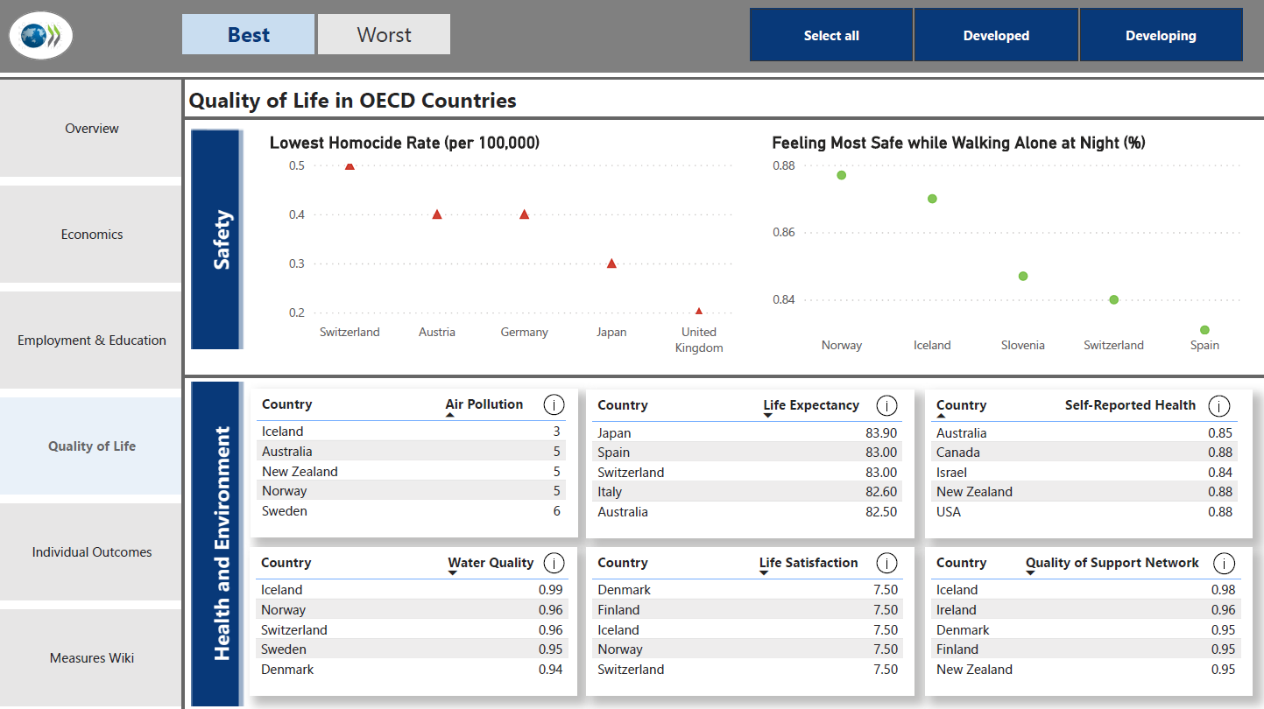
Focusing on OECD countries, this slide offers a snapshot of public safety and health metrics, with interactive charts that highlight extremes in the data
Appendix
PowerBI – Quality of Life
Comprehensive Quality of Life Indicators
The slide features different quality of life metrics for OECD countries, such as homicide rates, air pollution levels, life expectancy etc.
Dashboard View 4
Top and Bottom Filters
Tabs labeled 'Top' and 'Bottom' indicate interactive elements that could filter the displayed data to show either the countries with the best or worst indicators in each category.
Scatter Plots
visually compare countries based on homicide rates, feeling safe walking alone etc., using color-coded markers for intuitive understanding of the data.
Country Ranking Tables
Six tables list the top/bottom countries for various indicators, providing a clear ranking for easy comparison.

Slide 13
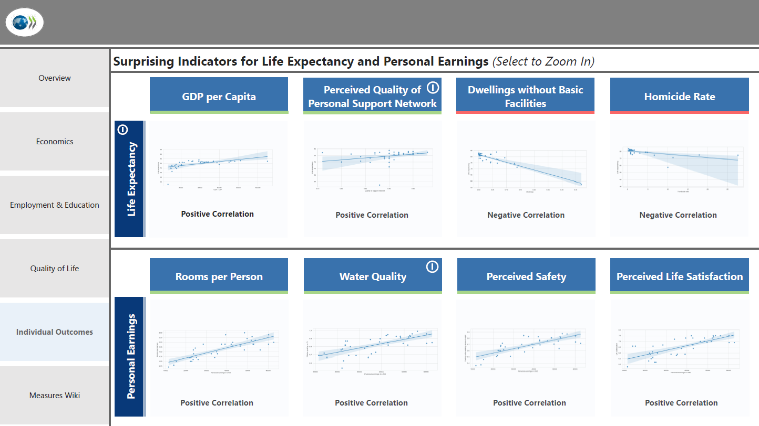
A detailed cross-analysis of life quality indicators reveals their positive or negative correlations with personal earnings and life expectancy in OECD nations
Appendix
PowerBI – Data Analysis
Correlation Analysis
This slide offers a visual representation of the correlation between the most interesting relationships, featuring scatter plots for each indicator.
Dashboard View 5
Positive and Negative Correlations
Each scatter plot is labeled as having a positive or negative correlation, providing an at-a-glance understanding of how each factor might relate to life expectancy and personal earnings.
Interactive Detail Viewing
With 'Select to Zoom In’, the slide allows users to focus on specific details of each scatter plot for a more detailed examination.
Significant Relationships
Each context shown serves to represent the most valuable insights from the dataset.

